Slide 1
Analysis of Birth Weight and Smoking in the U.S.

Slide 2
Overview and problem statement
We are interested in factors influencing the birth weight of newborns in the United States.
It is known that low birth weight has adverse health effects.
Does birth weight differ between smokers and non-smokers?
By how much on average?
Notes:
We are framing this problem in terms of a clear business need. And asking the question, what is this analysis actually going to do for our business, right? Remember, it’s our world, the statistics are just living in it!

Slide 3
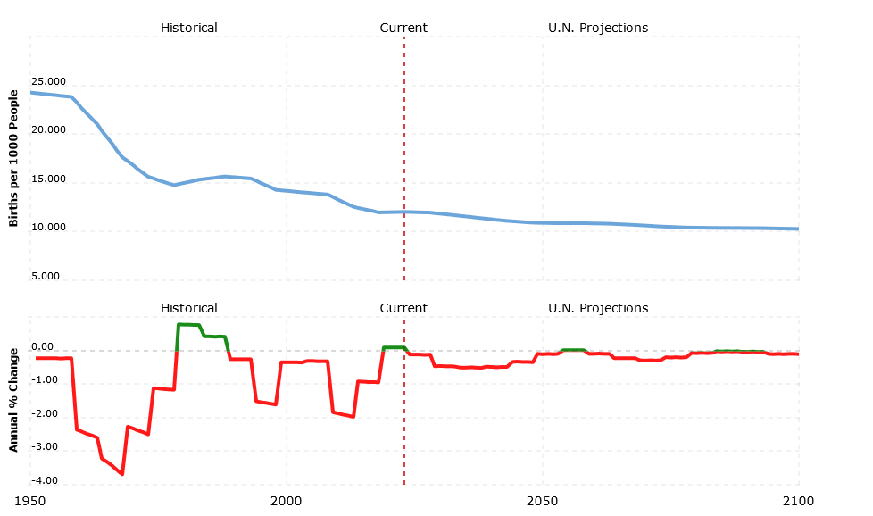
Birth rates in the U.S.
In 1960, the birth rate was 22.696 births per 1000 people.
In 2023, the rate dropped to 12.023 births per 1000 people.
It is imperative that Americans have healthy babies in the future.
Source: United Nations - World Population
Notes:
Moving from research question to some kind of hypothesis -- you want to use logic, theory and prior empirical evidence to move toward some hypotheses you can test. This is why domain expertise cannot be overlooked among data scientists.

Slide 4
Impact of Low Birth Weight on Newborns
Low birth weight contributes to a range of poor health outcomes,
including:
Fetal mortality and morbidity
Inhibited growth and cognitive development
Heat Disease, cancer, and diabetes
Infants with low birth weight are 20 times more likely to die.
Source: WHO Database on Low birth weight
Notes:
We are framing this problem in terms of a clear business need. And asking the question, what is this analysis actually going to do for our business, right? Remember, it’s our world, the statistics are just living in it!

Slide 5
Data analyzed
Approximately 1,200 newborns from Jan 2017 - Dec 2017.
Data includes birth weight, length of pregnancy, and whether the mother was a smoker or non-smoker.
Raw data available here
Notes:
Set the stage a bit -- where is the data coming from? Be as transparent as possible. Explain to the audience what you were thinking about data collection in terms of what data was necessary and how that in turn shaped your thinking on the kind of analysis that would be most appropriate given the objective.

Slide 6
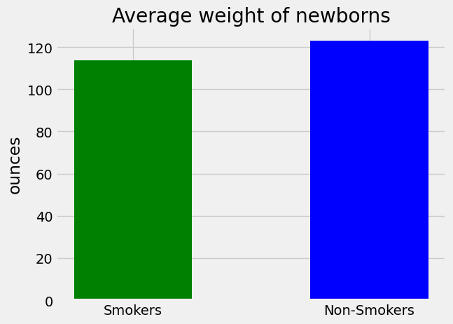
Statistically significant difference between mothers who smoke and non-smokers:
With 95% confidence, the average weight of newborns from non-smokers is between 7 and 11 ounces higher than newborns from smokers.
The average weight of newborns from smokers is 114 ounces while the average weight of non-smokers is 123 ounces.
Notes:
A statistical method is not a story, but we can tell a story from the statistics. For example, using confidence intervals we can put into dollars what we think would happen if we make some business move, given the data that we have.
The words “t-test,” “normality,” “independent samples” etc did not come up at all in this explanation! Although someone who does know about this stuff can still have confidence in the results with the way you have laid out the story and the quantifiable results.

Slide 7

Other factors influencing birth weight?
Alcohol consumption and the total length of the pregnancy.
A/B test differences on different U.S. datasets in the 2000s.
Notes:
https://unsplash.com/photos/OX_en7CXMj4
Then we want to move to recommendations, what is the call to action? What should your audience do now that they know what you have told them?

Slide 8
Recommendations to mothers
Limit or stop smoking while pregnant to increase health of newborn.
Get regular prenatal checkups.
Eat healthy and stay physically active.
Notes:
Set the stage a bit -- where is the data coming from? Be as transparent as possible. Explain to the audience what you were thinking about data collection in terms of what data was necessary and how that in turn shaped your thinking on the kind of analysis that would be most appropriate given the objective.

Slide 9
Questions?

Slide 10
Thank You

